Slide 1
Test -1
Based on
Generating Test Cases From Use Cases by Jim Heumann, Requirements Management Evangelist Rational Software

Slide 2
Examples software bugs
In the 1991 Gulf war, some Patriot missiles failed to hit incoming Iraqi Scud missiles, which therefore killed people on the ground. Accumulated rounding errors in the control software's clocks caused large navigation errors.
Errors in the software controlling the baggage handling system of Denver International Airport delayed the entire airport's opening by a year (1994-1995), causing losses of around 360 million dollars. Since September 2005 the computer-controlled baggage system has not been used; manual baggage handling saves one million dollars a month.
The first launch of the European Ariane 5 rocket failed (1996), causing losses of hundreds of million dollars. The problem was a buffer overflow in control software taken over from Ariane 4. The software had not been re-tested - to save money.
Errors in a new train control system deployed in Berlin (1998) caused train cancellations and delays for weeks.
Errors in poorly designed control software in the Therac-25 radio-therapy equipment (1987) exposed several cancer patients to heavy doses of radiation, killing some.
Source: https://www.itu.dk/people/sestoft/papers/softwaretesting.pdf

Slide 3
Examples software bugs
Top software failures 2015/2016: Amazon, RBS, Starbucks - the worst software glitches this year
http://www.computerworlduk.com/galleries/infrastructure/top-10-software-failures-of-2014-3599618/
What is Software Testing & Why Testing is Important?
https://youtu.be/TDynSmrzpXw

Slide 4
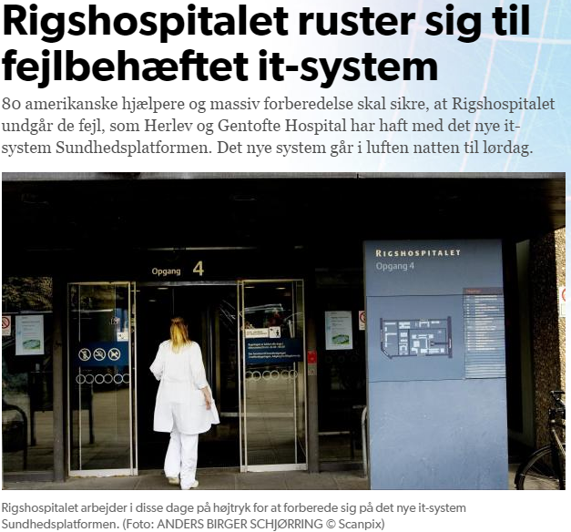
Examples software bugs
http://www.dr.dk/nyheder/regionale/hovedstadsomraadet/it-system-koster-region-over-300-millioner-i-tabte-indtaegter
http://www.dr.dk/nyheder/indland/rigshospitalet-ruster-sig-til-fejlbehaeftet-it-system#!/

Slide 5
How do discover errors…
Not by accident when the program is being used
But in a systematic and effective way

Slide 6
??? Test as discipline in UP
Find and document defects in software quality
Prove the validity of the assumptions made in design and requirement specifications through concrete demonstration
Validate that the software product functions as designed
Validate that the software product functions as required (that is, the requirements have been implemented appropriately)

Slide 7
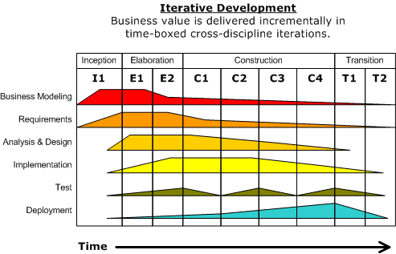
Test as discipline in UP
Testing during all the development process
Continuosly verify quality for each artifact, activity and deliverable.

Slide 8
? Test in UP
Building the test model, which describes how integration and system tests will exercise executable components from the implementation model. The test model also describes how the team will perform those tests as well as unit tests.
The test model contains test cases that are often derived directly from use cases. Testers perform black-box testing using the original use case text.

Slide 9
Test cases
A test case is a set of test inputs, execution conditions, and expected results developed for a particular objective, e.g.:
Verify compliance with a specific requirement
To exercise program parts: methods, etc.
The purpose of a test case is to identify and communicate conditions that will be implemented in test.

Slide 10
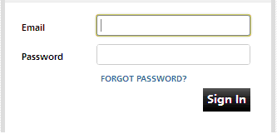
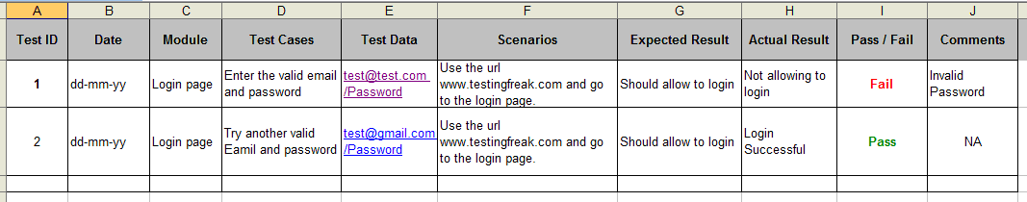
Example test cases for validation of email field on login page
Source: http://testingfreak.com/test-case/

Slide 11
Test process (iterative)
Selection
Test cases are selected
Execution
The program under test is executed
Failures can occur and failures must be identified and corrected.
Evaluation
Assess the degree of adequacy of the performed test.

Slide 12
Test process
Test design and test planning are dependent on human skills ☺
Test execution and coverage evaluation can be automated

Slide 13
Test cases
Test cases are key to the process because they identify and communicate the conditions that will be implemented in test and are necessary to verify successful and acceptable implementation of the product requirements.
They are all about making sure that the product fulfills the requirements of the system.

Slide 14
Functional testing at system level
Testing focuses on user-visible actions and user-recognizable output from the system.
Focus on requirements
functional (use cases)
non-functional
LATER IN THE COURSE (e.g. usability testing)

Slide 15
Functional requirements Some advantages
Establish and maintain agreement with the customers and other stakeholders on what the system should do
Provide system developers with a better understanding of the system requirements
Define the boundaries of (delimit) the system
Provide a basis for estimating the cost and time to develop the system
Provide a basis for planning the technical contents of iterations

Slide 16
Test cases generation at system level
!

Slide 17
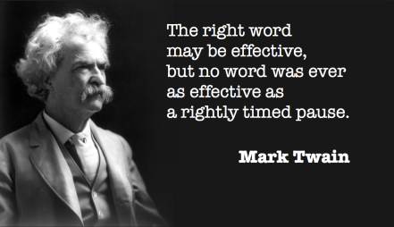

Slide 18
Use cases – fully dressed
Special requirements…. (non functional)
Technology and data variations list
Miscellaneous
Acceptance criteria: The exit criteria that a component or system must satisfy in order to be accepted by a user, customer, or other authorized entity. [IEEE 610]
Additional rules (Business rules): Like interest rate must be between 0 – 20 %

Slide 19
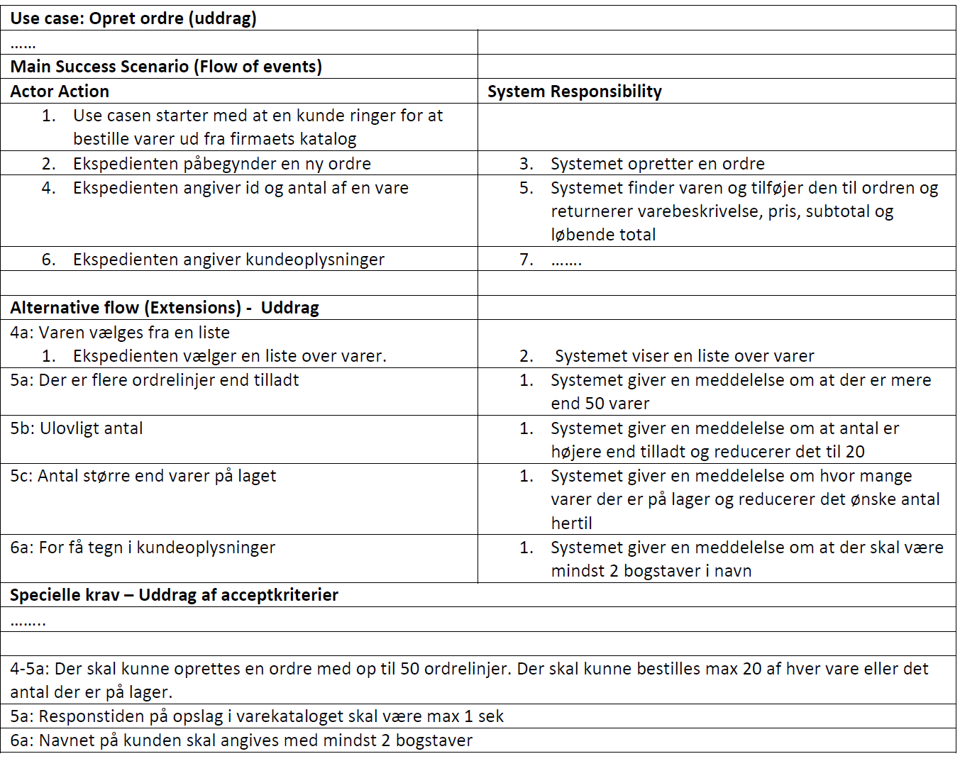
Note: Acceptance criteria / Additional rules
Use cases
– fully dressed
Special Requirements
Template Larman p. 66-67

Slide 20
Test cases generation at system level
In UP system functional requirements are defined by use cases.
Via testing we want to make sure that the product fulfills the requirements.
Test cases identify and communicate the conditions that will be implemented in test and are necessary to verify successful and acceptable implementation of the product requirements.

Slide 21
Test cases generation at system level
We can generate test cases from the use cases.
The use cases can be written too general, when we test we need to be more precise on the behavior of the systems, for example referring to the login page, can the system accept passwords of just one letter ?

Slide 22
Test cases generation at system level
The most important part of a use case for generating test cases is the flow of events.
The two main parts of the flow of events are the basic flow of events (main success scenario) and the alternate flows of events.
The alternate flows of events covers variations of the normal behavior or behavior of an optional or exceptional character relative to normal behavior.

Slide 23
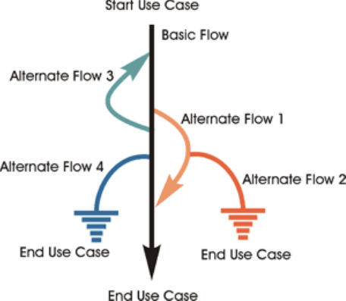
Scenario (Use case scenario)
A scenario is an instance of a use case, or a complete "path" through the use case.
E.g.
Scenario 1: Basic Flow
Scenario 2: Basic Flow, Alternate Flow 1
Scenario 3: Basic Flow, Alternate Flow 1, Alternate Flow 2

Slide 24
Generating test cases from use cases
Process for generating test cases from a fully detailed use case:
For each use case, generate a full set of scenarios.
For each scenario, identify at least one test case and the conditions that will make it "execute."
For each test case, identify the data values with which to test.

Slide 25
Fremgangsmåde systemtest
Grundlag (Baseret på fully-dressed use case)
Fastlæg happy day og alternative flows (all flow of events)
Opstil scenarie for hvert flow
Opstil mindst 1 test case for hvert use case scenarie
Tilføj data værdier til hver test case
Hvorfor bruge en fremgangsmåde?

Slide 26
Example
Consider a use case: University Course Registration
The basic flow is:
Logon
Create a schedule
Obtain course information
Select courses
Submit schedule
Display completed schedule

Slide 27
Example cont.
List of alternate flows:
Unidentified student
Quit before schedule submitted
Unfulfilled prerequisites, course full, or schedule conflicts
Course catalog system unvailable
Course registration closed

Slide 28
Step 1. Generate scenario
Read the use-case textual description and identify each combination of main and alternate flows -- the scenarios -- and create a scenario matrix

Slide 29
Step 2. Identify test cases
This specific matrix shows which conditions are being tested for each test case.
Do no yet supply data values but use:
V for valid
I for invalid
n/a when it is not necessary to supply a data value
By looking at the Vs and Is you should determine whether you have identified a sufficient number of test cases.

Slide 30
Step 3. Identify data values to test
Substitute actual data values for the Is and Vs.

Slide 31
Exercise
Exercise: Test cases for system test
Modul 2: Exercise_Test-cases-for-system-test

